Slide 1

UN Sustainability Development Goals
By Vera Arrebola

Slide 2

Outline
Problem Scenario.
Data Set description.
Prediction models:
Linear Regression.
Random Forest.
Decision Tree Regressor.
Conclusions.

Slide 3

Problem Scenario
Target Audience:
Policy makers, politicians, companies and the general public.
Objective:
Understand how every SDG goal affects Goal 17.
Find the best predictive model.

Slide 4
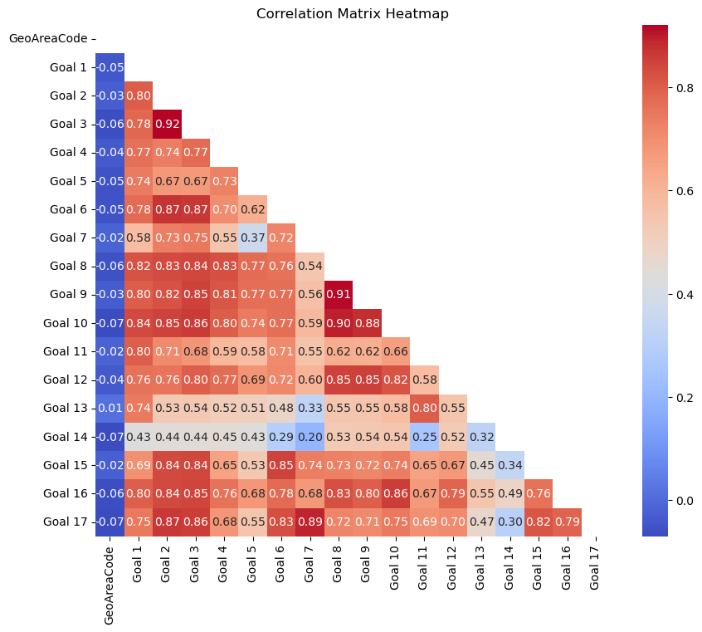
Data Set Description
Rows: 249
Columns: 19
Geo Area Code | Geo Area Name | Goal 1 | Goal 2 | Goal 3 | Goal 4 | Goal 5 | Goal 6 | Goal 7 | Goal 8 | Goal 9 | Goal 10 | Goal 11 | Goal 12 | Goal 13 | Goal 14 | Goal 15 | Goal 16 | Goal 17
4 | Afghanistan | 28.10% | 51.67% | 70.90% | 32.05% | 6.94% | 73.13% | 100% | 52.08% | 50% | 35.83% | 30.34% | 26.36% | 11.56% | 0% | 49.76% | 18.75% | 69.07%
248 | Åland Islands | 0% | 4.17% | 0% | 0% | 0% | 7.14% | 0% | 0% | 0% | 0% | 0% | 0% | 0% | 0% | 16.39% | 0% | 2.08%
8 | Albania | 46.90% | 49.58% | 65.06% | 68.52% | 30.56% | 75.83% | 80% | 46.88% | 66.07% | 52.31% | 25.86% | 30.91% | 6% | 35.38% | 45.71% | 15.30% | 61.35%
12 | Algeria | 35.71% | 50.83% | 68.59% | 39.14% | 4.17% | 66.35% | 100% | 51.04% | 60.94% | 44.40% | 37.50% | 35.91% | 16.67% | 16.15% | 59.05% | 21.39% | 64.26%
Strongest Relationships with Label:
Goals 2, 3, 6, 7 and 15

Slide 5
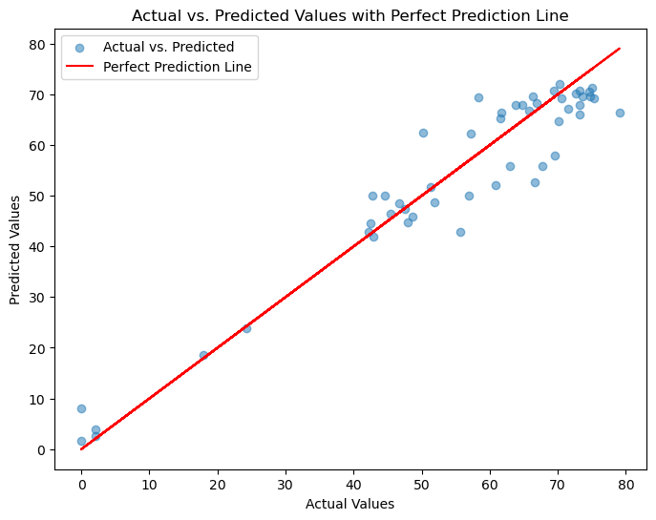
Prediction models
Best Model: Random Forest
Model | R squared | MSE
Linear Regression | 0.885 | 49.204
Random Forest | 0.916 | 35.739
Decision Tree Regressor | 0.851 | 63.634

Slide 6




Conclusions
Random Forest
Sustainability Progress
Sustainability Progress

